Slide 1
REAL ESTATE DATA ANALYSIS

Slide 2
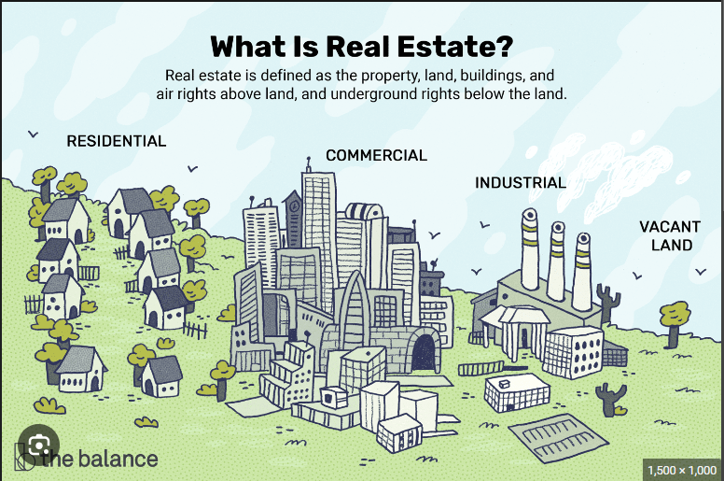

Slide 3

Introduction
The real estate market can be influenced by many factors such as interest rates, economic conditions, government policies, and demographics. Interest rates can affect the cost of borrowing money to purchase a home or property. When interest rates are low, it can make it easier for people to buy homes or properties. Economic conditions such as employment rates and consumer confidence can also impact the real estate market. Government policies such as tax incentives for homebuyers or zoning regulations can also affect the real estate market. Demographics such as population growth and migration patterns can also influence the real estate market.

Slide 4

Problem Statement
We were tasked with using the king county dataset on house sales. We are to use the data to optimize the recommendations you can use with your clients. The project aims to provide a deeper insight on the factors affecting the prices of property in the area.

Slide 5
Objectives
Main Objective
- To understand various features that affect the price of a house.
Specific Objectives
- To build a multiple linear regression model that will help us identify how different factors affect the price of a property.
- Identify which factors have the most positive influence and which have negative influence on the price of the house.
- Provide information to buyers, sellers and contractors(all clients)

Slide 6
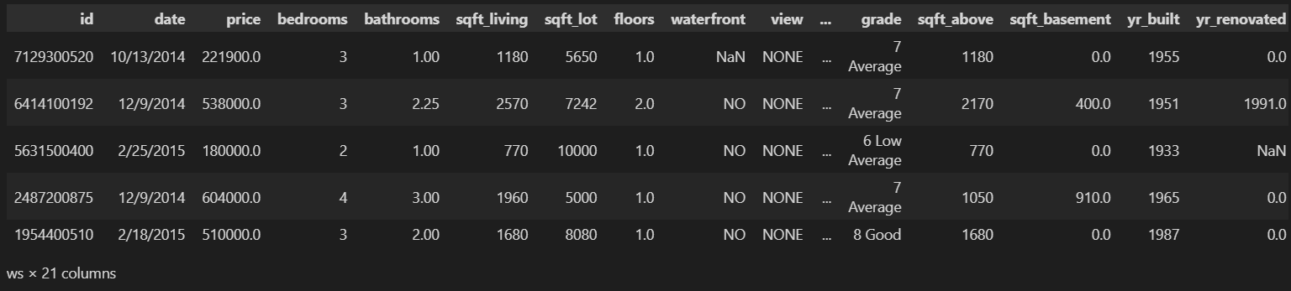
Data Understanding
The data provided had several columns with price as our target. The other columns we are to use are to be used to provide an insight into how price behaves when associated with a variable.

Slide 7
Modeling
We deployed the OLS method to generate our regression model. The model results weren’t desirable at first but after iteration numerous times we finally end up with a model we can say is statistically significant and relays findings in an easy manner.

Slide 8
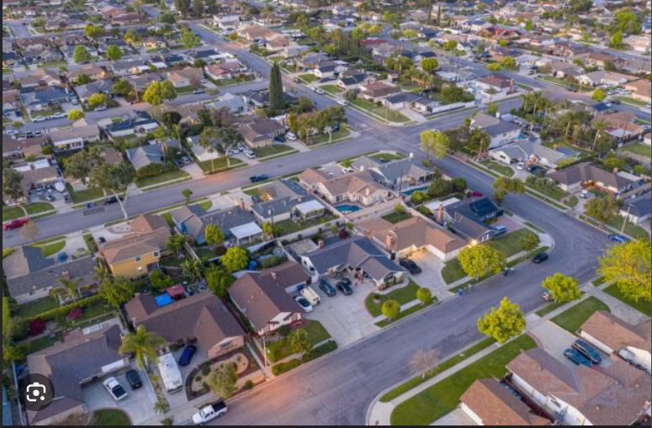
Modeling
Our last model relayed the following findings:
- sqft_living: A one-unit increase in square footage of the home results in a 0.02% increase in log_price while holding all other independent variables constant.
- sqft_basement: A one-unit increase in square footage of the basement results in a 0.008% decrease in log_price while holding all other independent variables constant.

Slide 9

Findings
- bedrooms: A one-unit increase in the number of bedrooms results in a 2.09%% decrease in log_price while holding all other independent variables constant.
- bathrooms: A one-unit increase in the number of bathrooms results in a 5.63% increase in log_price while holding all other independent variables constant.
- view: A one-unit increase in view index results in a 5.9% increase in log_price while holding all other independent variables constant.

Slide 10
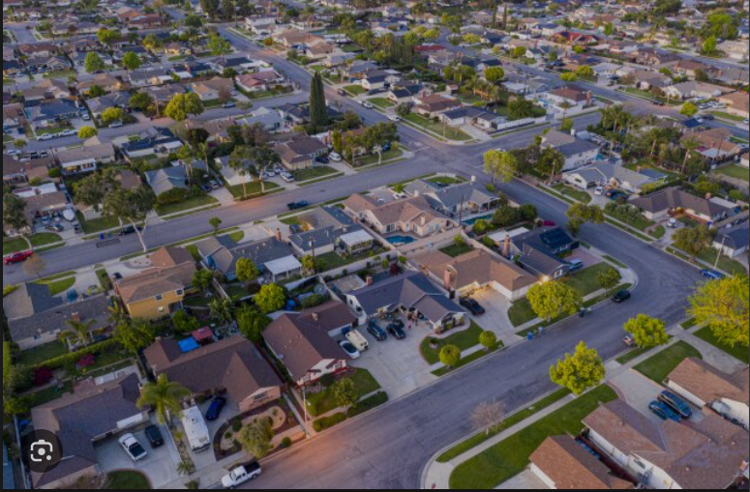
Findings
- waterfront: A dummy variable indicating whether the property is located on a waterfront (1) or not (0). If waterfront=1, then log_price increases by 33.61% while holding all other independent variables constant.
- grade_levels: A one unit increase in grade_levels of the property results in a 17.21% increase in log_price.
- condition: A one unit increase in condition status of the property leads to a 6.48% increase in log_price.

Slide 11

Findings
- renovated: A dummy variable indicating whether the property had been renovated (1) or not (0). If renovated=1, then log_price increases by 7.87% while holding all other independent variables constant.
- age: A one-unit increase in age of the house results in a 0.17% increase in log_price while holding all other independent variables constant.
- distance: A one-unit increase in distance from the house to downtown Seattle results in a 1.74% decrease in log_price while holding all other independent variables constant

Slide 12
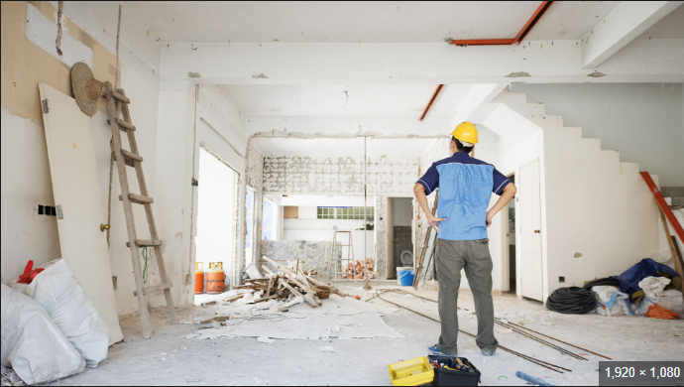
Recommendations
The agency should advise sellers to renovate their properties before putting them in the market as it will increase the relative price of the property.

Slide 13

Recommendations
2. The agency should advise buyers of properties on the market depending on the budget of the buyers, the factors that affect price of a property hence be able to effectively deliver the best services to the buyers.

Slide 14

Recommendations
3. The agency should advise contractors and clients on how different types of properties perform in the real estate market hence one can select a property type which is likely to be more profitable in the market as real estate is all about profit margins.

Slide 15
Next steps
The real estate agency might advise buyers of properties on the market depending on the budget of the buyers and the factors that affect the price of a property. If a buyer wants to buy a property on the waterfront, the real estate agency would advise the client that a property on the waterfront will likely have a higher price than that which is not located at the waterfront.
This will be applied widely depending on what the client wants or doesn’t want.
Another example is that the real estate agency might suggest to the contractor/client to build a higher grade-level property such as a mansion and also near the waterfront as these will boost the price of the property hence making it more profitable.

Slide 16

THANK YOU
END

